Slide 1
COT5615: Math for Intelligent Systems I
Anand Rangarajan
Lecture 14

Slide 2
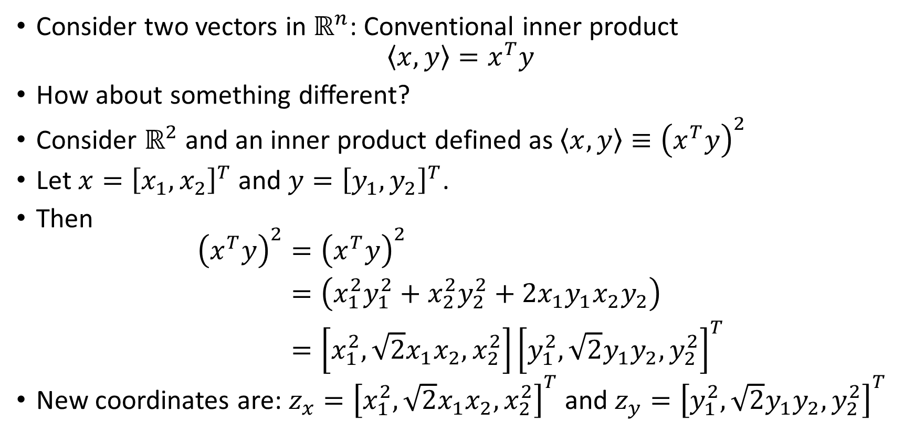
Hilbert Spaces: Motivation
Consider two vectors in $ℝ^{n}$: Conventional inner product
$$\left\langle x,y\right\rangle =x^{T}y$$
How about something different?
Consider $ℝ^{2}$ and an inner product defined as $\left\langle x,y\right\rangle ≡{\left(x^{T}y\right)}^{2}$
Let $x={\left[x_{1},x_{2}\right]}^{T}$ and $y={\left[y_{1},y_{2}\right]}^{T}$.
Then
$$\begin{aligned}{\left(x^{T}y\right)}^{2}&={\left(x^{T}y\right)}^{2} \\ &=\left(x_{1}^{2}y_{1}^{2}+x_{2}^{2}y_{2}^{2}+2x_{1}y_{1}x_{2}y_{2}\right) \\ &=\left[x_{1}^{2},\sqrt{2}x_{1}x_{2},x_{2}^{2}\right]{\left[y_{1}^{2},\sqrt{2}y_{1}y_{2},y_{2}^{2}\right]}^{T}\end{aligned}$$
New coordinates are: $z_{x}={\left[x_{1}^{2},\sqrt{2}x_{1}x_{2},x_{2}^{2}\right]}^{T}$ and $z_{y}={\left[y_{1}^{2},\sqrt{2}y_{1}y_{2},y_{2}^{2}\right]}^{T}$
Notes:
1) If 2 vectors have angle between them more than 90 degrees, then we can say that thet their inner product is negative.
2) The final value is of 3 dimentions in the above case.
3) Hilbert spaces do complete refeaturing. Means, it creates new features from existing features.
4) Now we are living in a curved space instead of euclidean space.

Slide 3
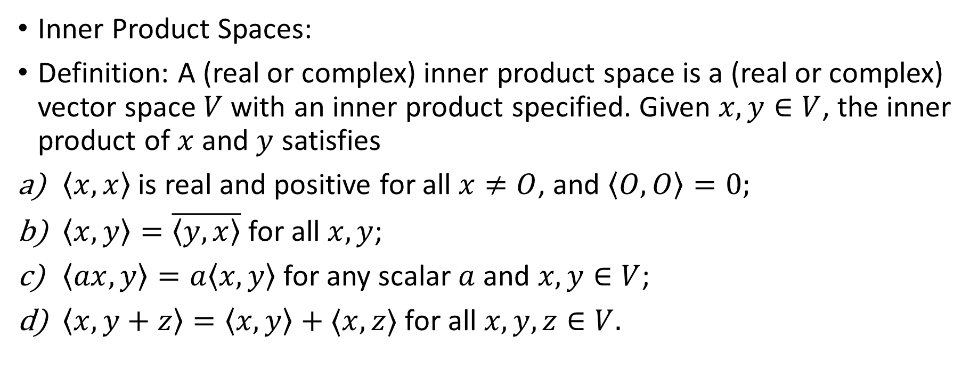
Introduction to Hilbert Spaces
Inner Product Spaces:
Definition: A (real or complex) inner product space is a (real or complex) vector space $V$ with an inner product specified. Given $x,y∈V$, the inner product of $x$ and $y$ satisfies
$\left\langle x,x\right\rangle$ is real and positive for all $x≠O$, and $\left\langle O,O\right\rangle =0;$
$\left\langle x,y\right\rangle =\overline{\left\langle y,x\right\rangle }$ for all $x,y$;
$\left\langle ax,y\right\rangle =a\left\langle x,y\right\rangle$ for any scalar $a$ and $x,y∈V$;
$\left\langle x,y+z\right\rangle =\left\langle x,y\right\rangle +⟨x,z⟩$ for all $x,y,z∈V.$
Notes:
1) Hilbert space is certain infinite dimention vector space, endowed with an inner product.

Slide 4
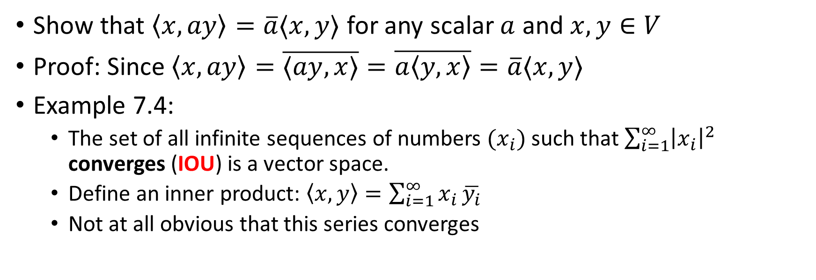
Addendum
Show that $\left\langle x,ay\right\rangle =\overline{a}⟨x,y⟩$ for any scalar $a$ and $x,y∈V$
Proof: Since $\left\langle x,ay\right\rangle =\overline{⟨ay,x⟩}=\overline{a\left\langle y,x\right\rangle }=\overline{a}⟨x,y⟩$
Example 7.4:
The set of all infinite sequences of numbers $(x_{i})$ such that $\sum_{i=1}^{∞}{{\left|x_{i}\right|}^{2}}$ converges (IOU) is a vector space.
Define an inner product: $\left\langle x,y\right\rangle =\sum_{i=1}^{∞}{x_{i}}\overline{y_{i}}$
Not at all obvious that this series converges

Slide 5
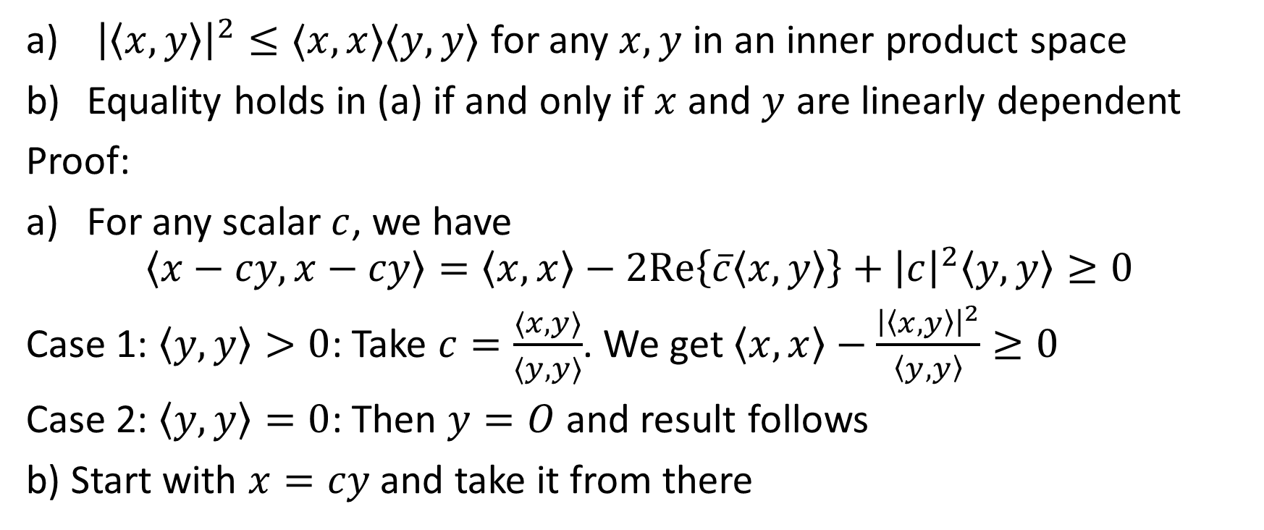
Schwarz Inequality
${\left|\left\langle x,y\right\rangle \right|}^{2}≤⟨x,x⟩⟨y,y⟩$ for any $x,y$ in an inner product space
Equality holds in (a) if and only if $x$ and $y$ are linearly dependent
Proof:
For any scalar $c$, we have
$$\left\langle x−cy,x−cy\right\rangle =\left\langle x,x\right\rangle −2Re\left\{\overline{c}\left\langle x,y\right\rangle \right\}+{\left|c\right|}^{2}\left\langle y,y\right\rangle ≥0$$
Case 1: $\left\langle y,y\right\rangle >0$: Take $c=\frac{⟨x,y⟩}{⟨y,y⟩}$. We get $\left\langle x,x\right\rangle −\frac{{\left|\left\langle x,y\right\rangle \right|}^{2}}{\left\langle y,y\right\rangle }≥0$
Case 2: $\left\langle y,y\right\rangle =0$: Then $y=O$ and result follows
b) Start with $x=cy$ and take it from there
Notes:
1) <x,x> - sort of length of x squared

Slide 6
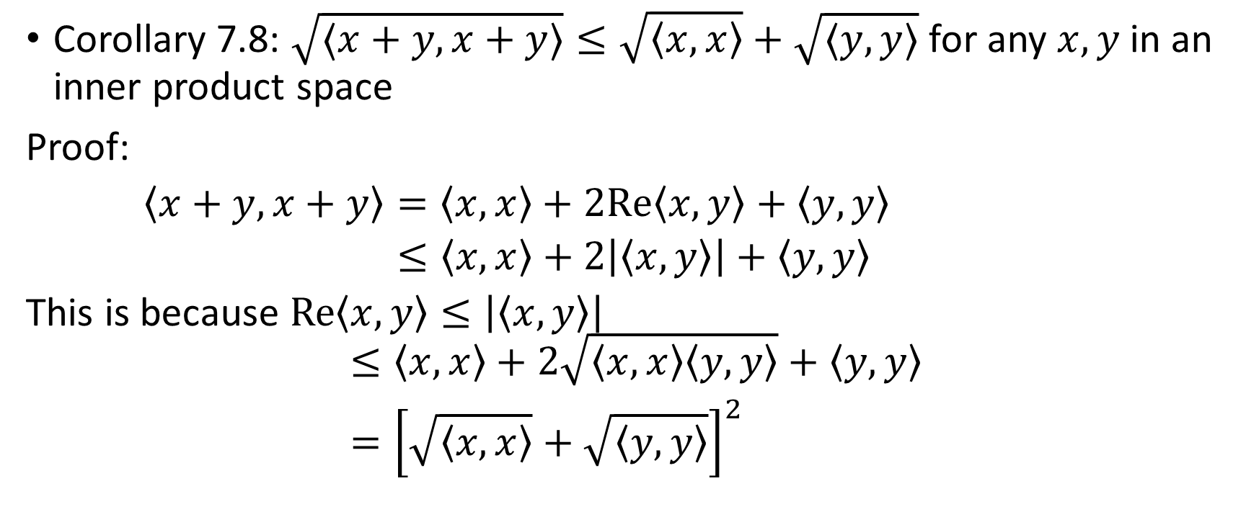
Triangle Inequality
Corollary 7.8: $\sqrt{⟨x+y,x+y⟩}≤\sqrt{\left\langle x,x\right\rangle }+\sqrt{⟨y,y⟩}$ for any $x,y$ in an inner product space
Proof:
$\begin{aligned}\left\langle x+y,x+y\right\rangle &=\left\langle x,x\right\rangle +2Re\left\langle x,y\right\rangle +\left\langle y,y\right\rangle \\ &≤\left\langle x,x\right\rangle +2\left|\left\langle x,y\right\rangle \right|+\left\langle y,y\right\rangle \end{aligned}$
This is because $Re\left\langle x,y\right\rangle ≤\left|\left\langle x,y\right\rangle \right|$
$$\begin{aligned}&≤\left\langle x,x\right\rangle +2\sqrt{\left\langle x,x\right\rangle \left\langle y,y\right\rangle }+\left\langle y,y\right\rangle \\ &={\left[\sqrt{\left\langle x,x\right\rangle }+\sqrt{\left\langle y,y\right\rangle }\right]}^{2}\end{aligned}$$

Slide 7
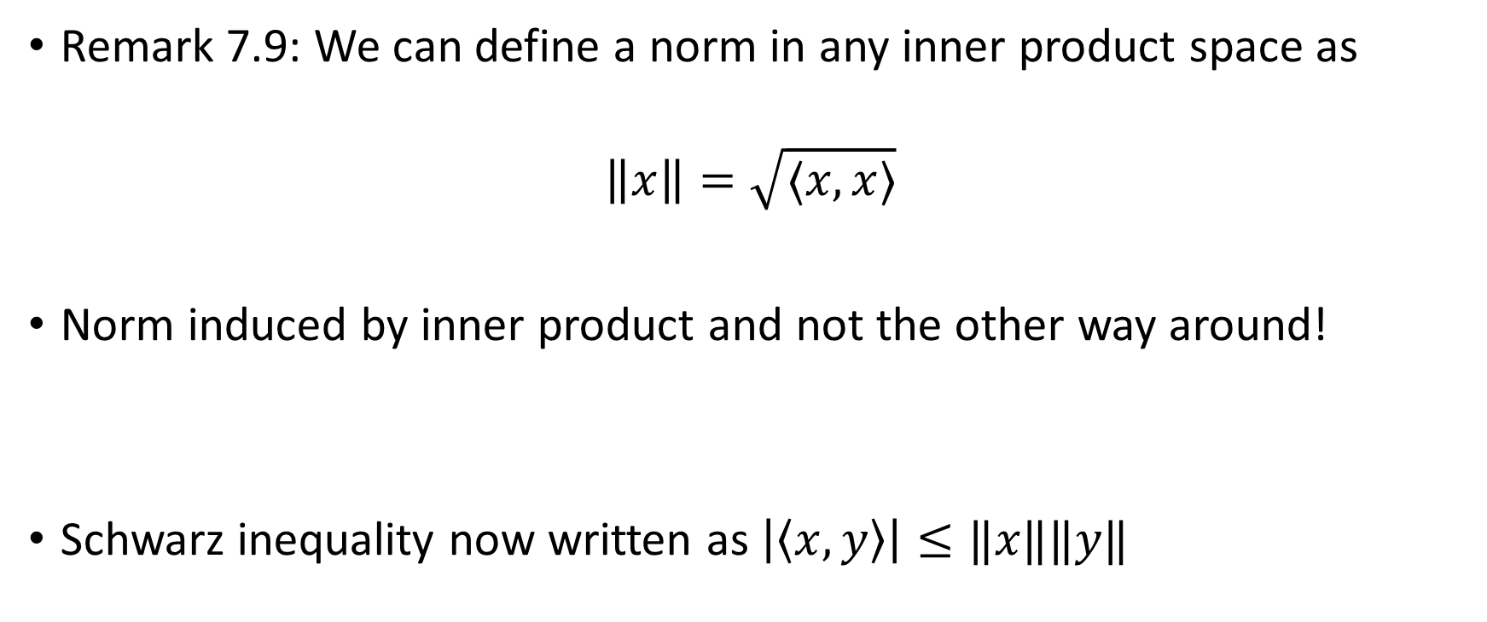
Norm
Remark 7.9: We can define a norm in any inner product space as
$$\left\|x\right\|=\sqrt{⟨x,x⟩}$$
Norm induced by inner product and not the other way around!
Schwarz inequality now written as $\left|\left\langle x,y\right\rangle \right|≤‖x‖‖y‖$

Slide 8
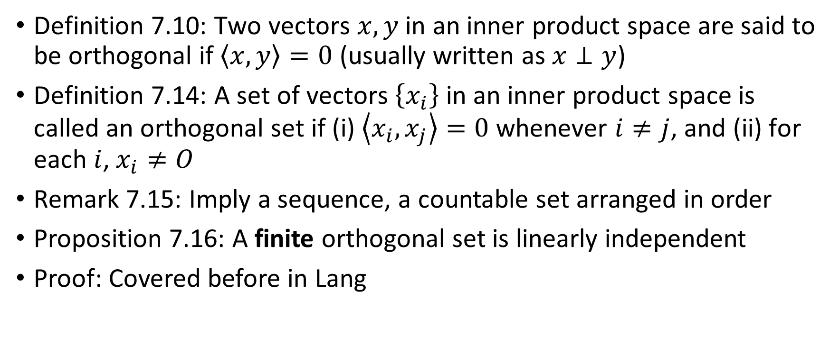
Orthogonality
Definition 7.10: Two vectors $x,y$ in an inner product space are said to be orthogonal if $\left\langle x,y\right\rangle =0$ (usually written as $x⊥y$)
Definition 7.14: A set of vectors $\left\{x_{i}\right\}$ in an inner product space is called an orthogonal set if (i) $\left\langle x_{i},x_{j}\right\rangle =0$ whenever $i≠j$, and (ii) for each $i$, $x_{i}≠O$
Remark 7.15: Imply a sequence, a countable set arranged in order
Proposition 7.16: A finite orthogonal set is linearly independent
Proof: Covered before in Lang

Slide 9
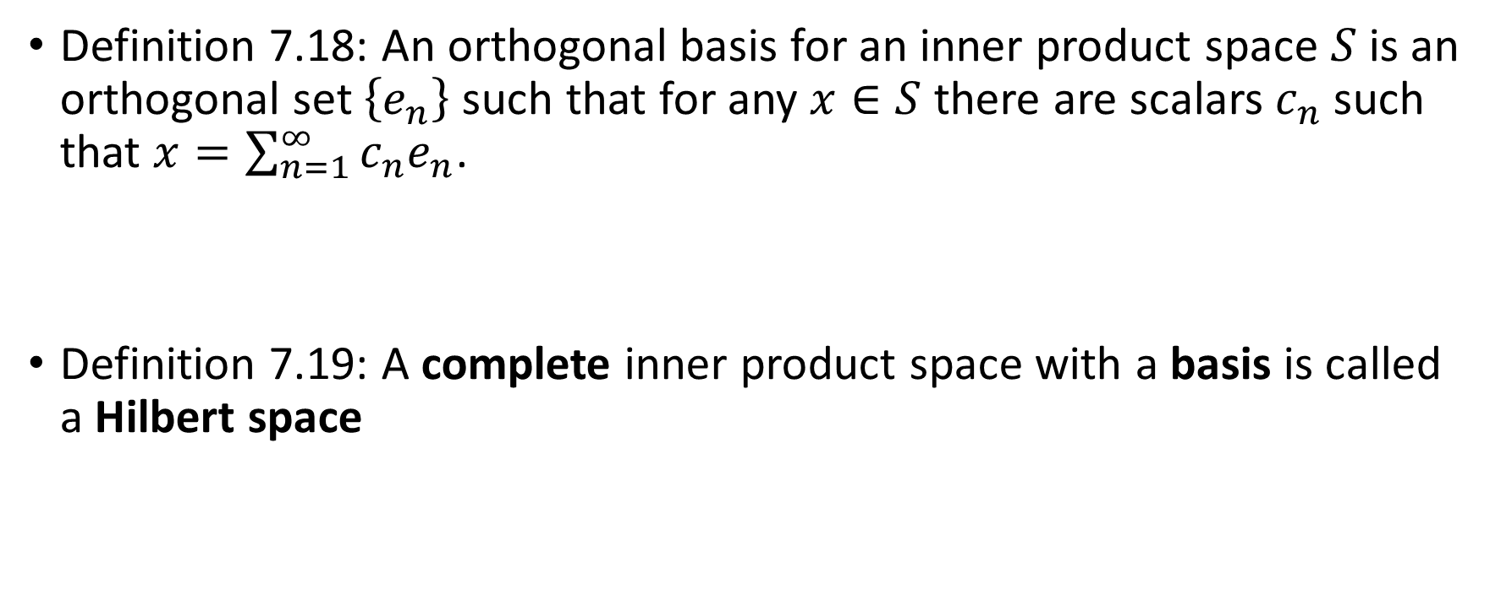
Basis
Definition 7.18: An orthogonal basis for an inner product space $S$ is an orthogonal set $\left\{e_{n}\right\}$ such that for any $x∈S$ there are scalars $c_{n}$ such that $x=\sum_{n=1}^{∞}{c_{n}e_{n}}$.
Definition 7.19: A complete inner product space with a basis is called a Hilbert space

Slide 10
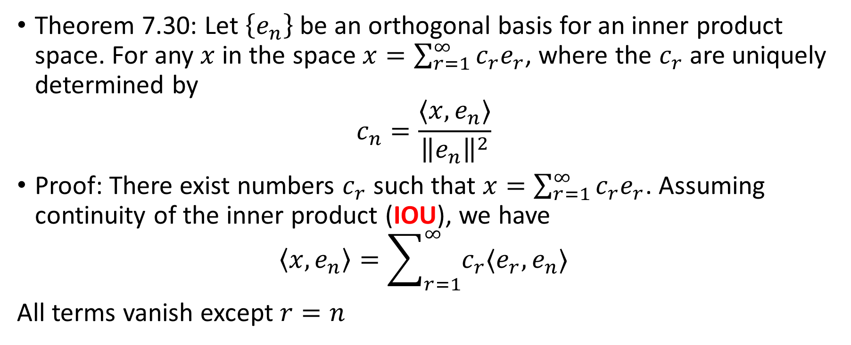
Basis coefficients
Theorem 7.30: Let $\left\{e_{n}\right\}$ be an orthogonal basis for an inner product space. For any $x$ in the space $x=\sum_{r=1}^{∞}{c_{r}e_{r}}$, where the $c_{r}$ are uniquely determined by
$$c_{n}=\frac{⟨x,e_{n}⟩}{{\left\|e_{n}\right\|}^{2}}$$
Proof: There exist numbers $c_{r}$ such that $x=\sum_{r=1}^{∞}{c_{r}e_{r}}$. Assuming continuity of the inner product (IOU), we have
$$\left\langle x,e_{n}\right\rangle =\sum_{r=1}^{∞}{c_{r}⟨e_{r},e_{n}⟩}$$
All terms vanish except $r=n$

Slide 11
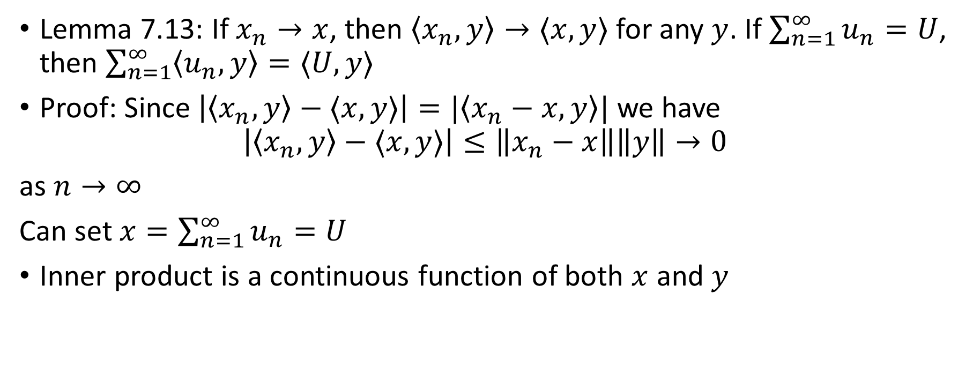
Continuity of inner product
Lemma 7.13: If $x_{n}→x$, then $\left\langle x_{n},y\right\rangle →⟨x,y⟩$ for any $y$. If $\sum_{n=1}^{∞}{u_{n}}=U$, then $\sum_{n=1}^{∞}{\left\langle u_{n},y\right\rangle =⟨U,y⟩}$
Proof: Since $\left|\left\langle x_{n},y\right\rangle −⟨x,y⟩\right|=|\left\langle x_{n}−x,y\right\rangle |$ we have
$$\left|\left\langle x_{n},y\right\rangle −⟨x,y⟩\right|≤\left\|x_{n}−x\right\|\left\|y\right\|→0$$
as $n→∞$
Can set $x=\sum_{n=1}^{∞}{u_{n}}=U$
Inner product is a continuous function of both $x$ and $y$

